Slide 1
JAVA BASIC
Well... not so basic anymore

Slide 2
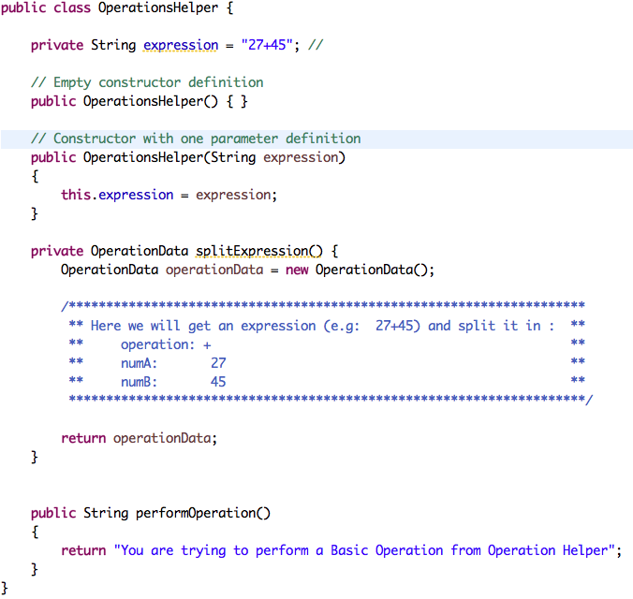

Slide 3
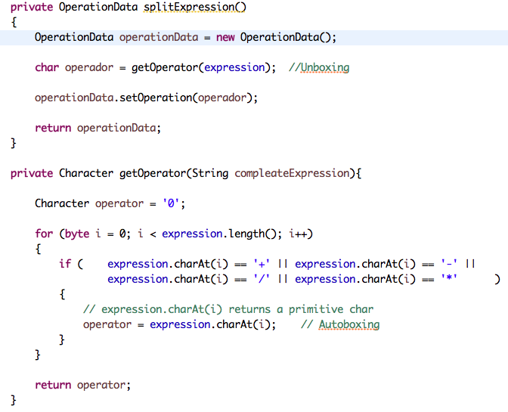
OperationsHelper
Key Concepts:
Logic Operators
AND ( && )
OR ( || )
Autoboxing
Unboxing

Slide 4
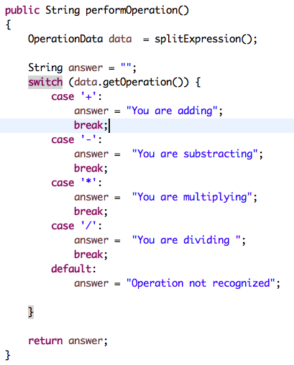
OperationHelper
Quick review
methods
return
switch

Slide 5
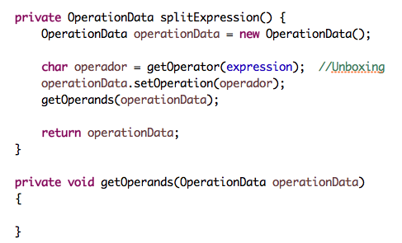
OperationHelper
Key Concept:
pass per reference

Slide 6
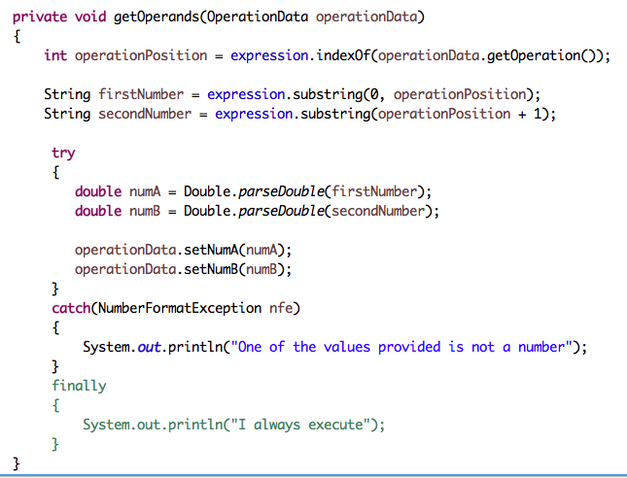
OperationHelper
Key Concept:
exception handling
try
catch
finally

Slide 7
¿Preguntas?

